Slide 1
Steps for executing test cases

Slide 2
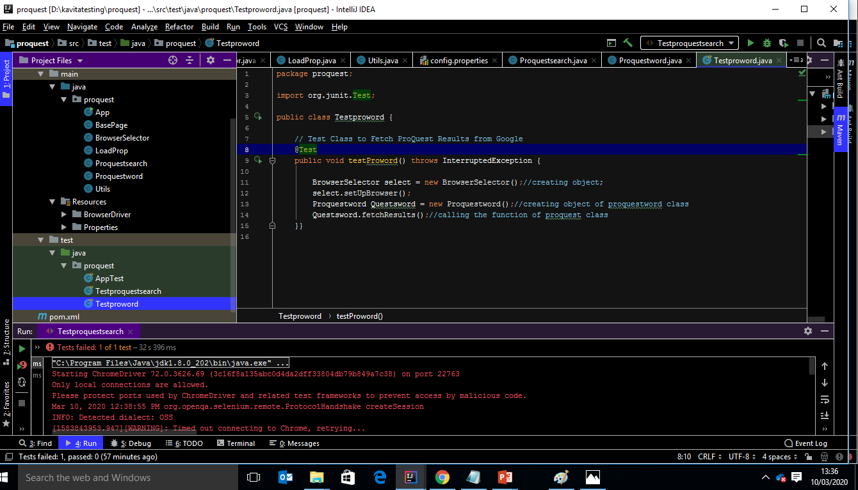
1. Follow the instructions to install the prerequisites 2. In Intellij open this project from the downloaded drive

Slide 3
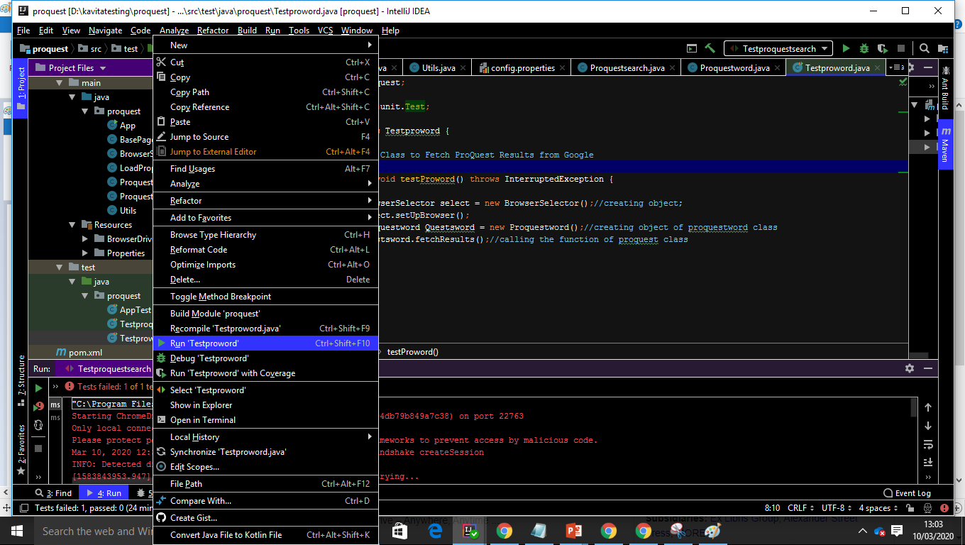
Test 1 : In this test you can see how to search proquest on google and store all the title in file. Execute Test: Right click on test class (testproword) in Java Test Folder. Result: Once test is passed you can see file is created under the project src main.

Slide 4
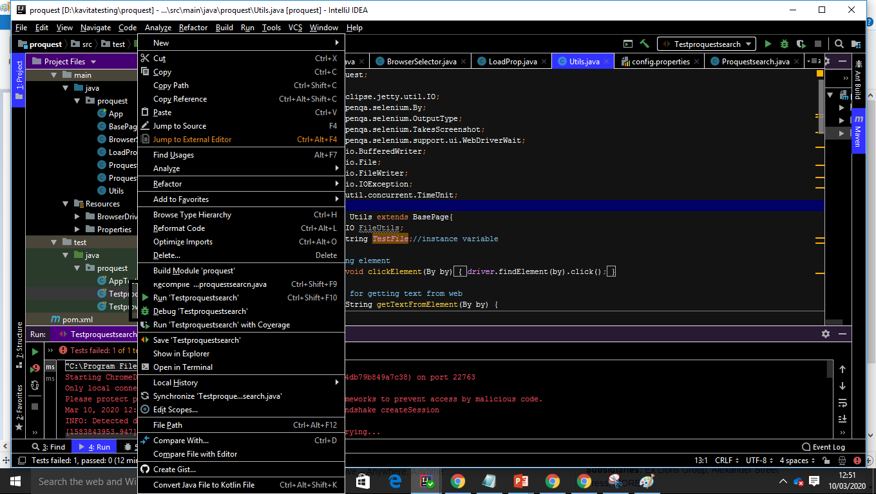
Test 2: In this test the user will be navigated to proquest site from google search result and to fetch the QA results and capture the screenshot. Execute Test: Right click on the Testproquestsearch and run this test Result: If the test case is passed then screenshot is saved in folder(proquest\ScreenShots)

